Slide 1
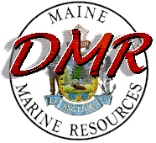

Aquaculture Education: Shellfish Sanitation
Bureau of Public Health

Slide 2
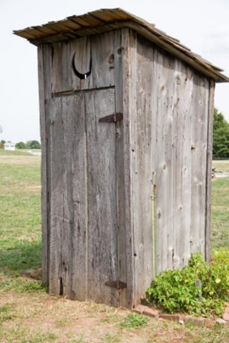
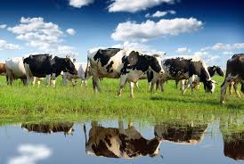
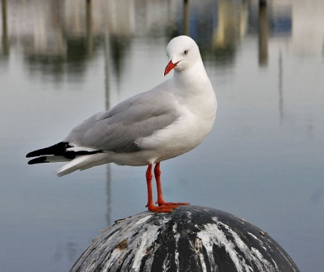
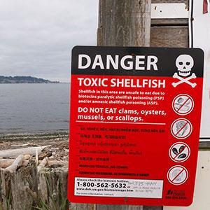
Why the concern?
Bivalve shellfish are filter feeders and pose a unique risk to consumers
Potentially vectors of illness due to raw or lightly cooked consumption
Can transmit viruses, vibrio and biotoxins
Clean water = clean bivalve shellfish
Prevention of post-harvest contamination = bivalve shellfish remain clean
Notes:
The premise of the NSSP is that clean water (pollution or biotoxins) means the shellfish are safe to eat

Slide 3

Bivalve Shellfish Filter Feeding
Notes:
Don’t panic, it takes about 5 seconds for the video to start

Slide 4
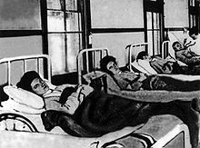
Shellfish and public health
In the late 1800’s and early 1900’s public health officials noticed large numbers of illnesses associated with consumption of raw bivalve shellfish
1924 there was a widespread typhoid fever outbreak
Surgeon General developed the first control measures to ensure a safe shellfish supply

Slide 5


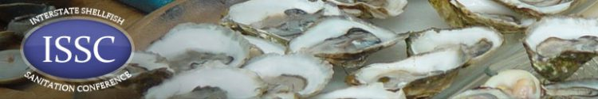
National Shellfish Sanitation Program
State/federal/industry cooperative program recognized by the U.S. Food and Drug Administration (FDA) and the Interstate Shellfish Sanitation Conference (ISSC)

Slide 6

NSSP – Model Ordinance
Growing Area Classification
Establishes water quality standards
Establishes biotoxin limits
Establishes safe handling and trace-back capability

Slide 7
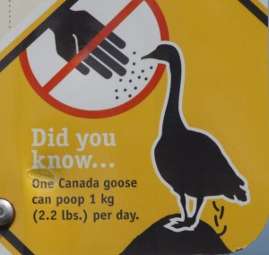
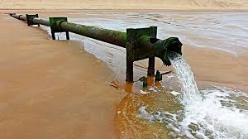
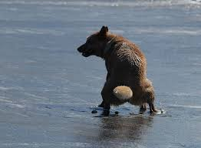
What is “clean water” with regard to bivalve shellfish sanitation
Evidence it is not contaminated by fecal material (from any animal, doesn’t matter)
Evidence biotoxins are not present (PSP, ASP, DSP)
Not contaminated by “other deleterious substances”

Slide 8
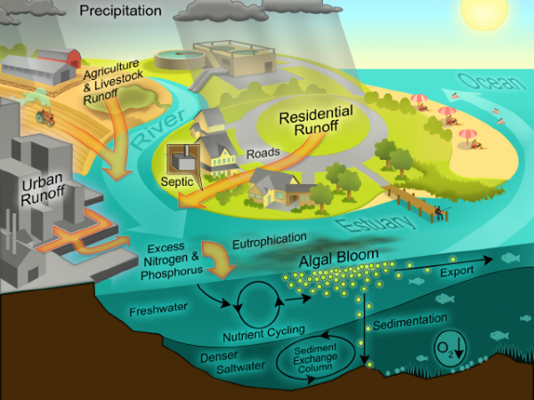

Slide 9
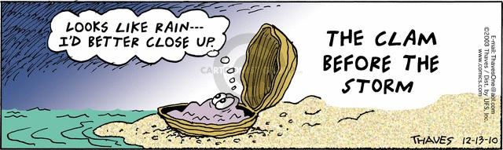
Growing Area Classifications
Approved – direct to market
Conditionally Approved – predictable conditions (rainfall, river flow, marinas, seasonal use)
Restricted – product must be depurated or relayed
Conditionally Restricted - predictable conditions, product must be depurated or relayed
Prohibited – nothing but seed harvest

Slide 10
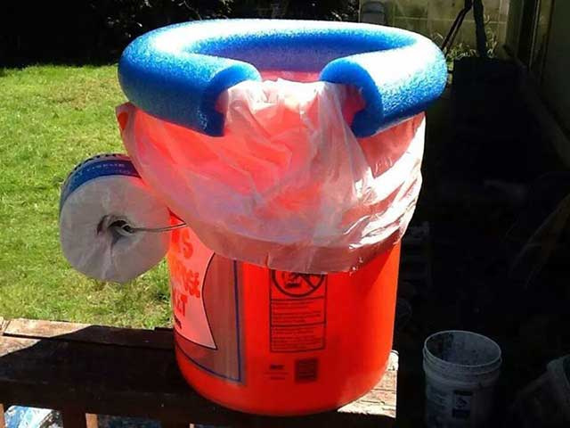
Marine Sanitation Devices
You must have a MSD available
Can be a 5 gal bucket with a tight fitting lid labeled “human waste only”
DO NOT put waste overboard; fecal material and vomitus can contaminate your shellfish and cause illnesses.

Slide 11
Growing Area Closures
https://www.maine.gov/dmr/shellfish-sanitation-management/closures/index.html
https://www.maine.gov/dmr/shellfish-sanitation-management/maps/index.html
Notes:
Just shows an example map and text legal notice

Slide 12
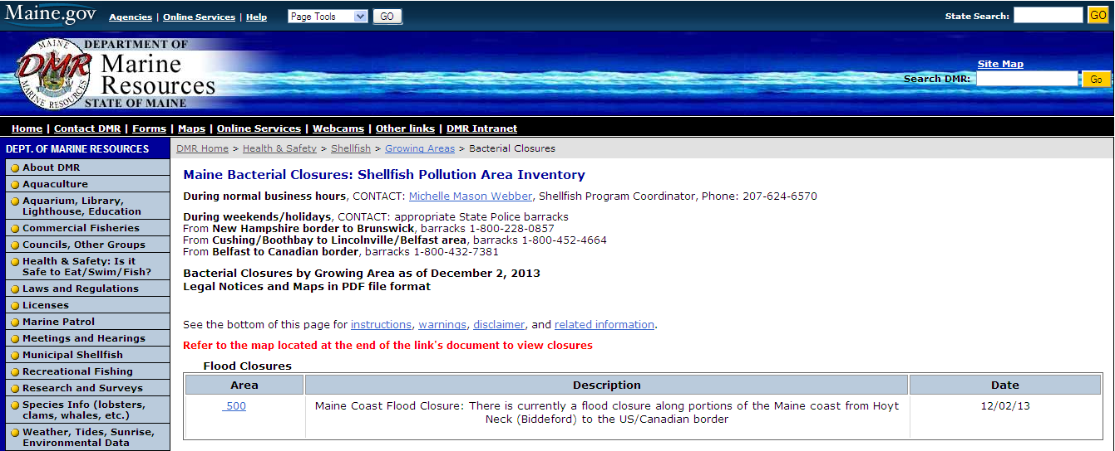

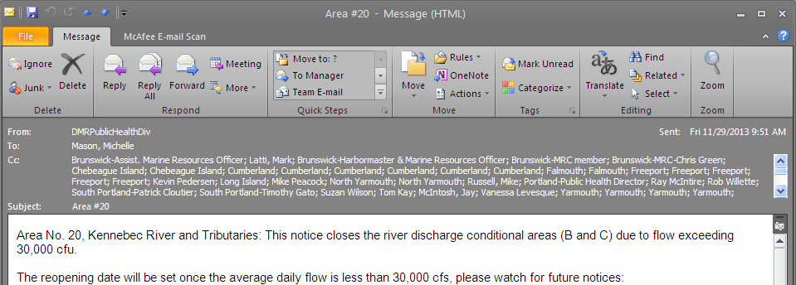
Closure Notifications
1-800-232-4733
or
207-624-7727
Notes:
Website, hotline and email

Slide 13
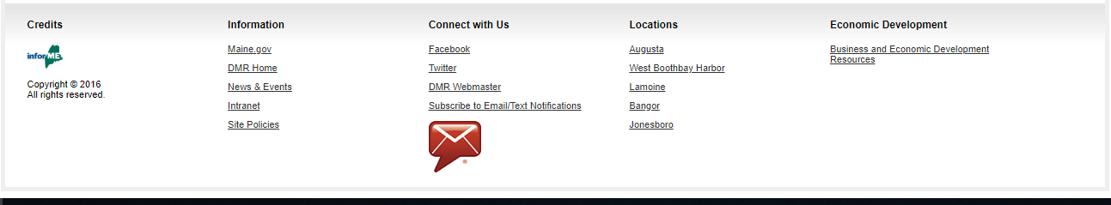
GovDelivery
https://public.govdelivery.com/accounts/MEDMR/subscriber/new

Slide 14
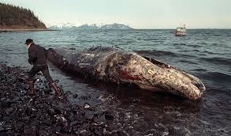
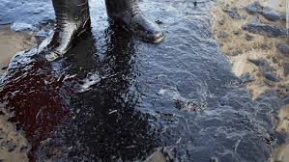
Emergency Closures
Biotoxin
Flood
Oil spill
Dead whales
Anything that will adversely impact water quality and shellfish sanitation

Slide 15
Marine Biotoxins

Slide 16
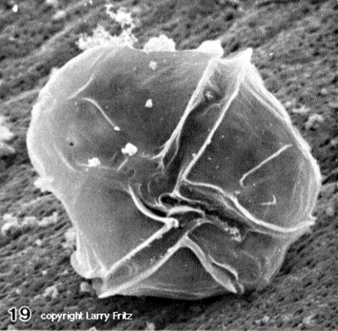
Biotoxin
Paralytic shellfish poisoning (PSP) is common in Maine
ASP and DSP are emerging issues in the Gulf of Maine
Caused by species of phytoplankton
DMR monitors phytoplankton and toxin in shellfish
People do get ill from biotoxins
You can’t see it in the water
It can kill people
It is not cooked out of shellfish
Shellfish taste normal

Slide 17
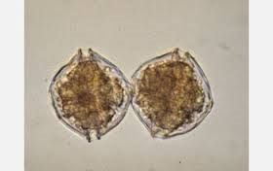
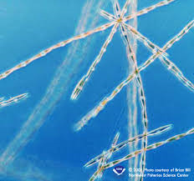
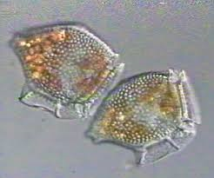
What are marine biotoxins
Caused by some species of marine phytoplankton
Species of concern in the Gulf of Maine:
Alexandrium
Pseudo nitzschia
Dinophysis

Slide 18
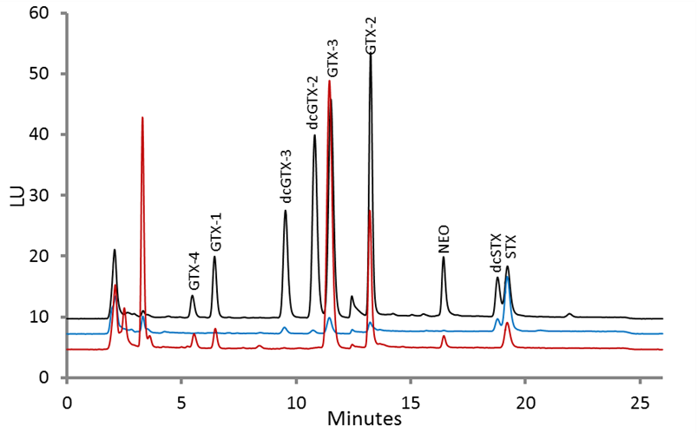
Biotoxin Sample Processing
Collect 12+ animals per station, transport to lab
Shuck, puree
HPLC PCOX for PSP; HPLC UV for ASP; LC-MS/MS for DSP

Slide 19
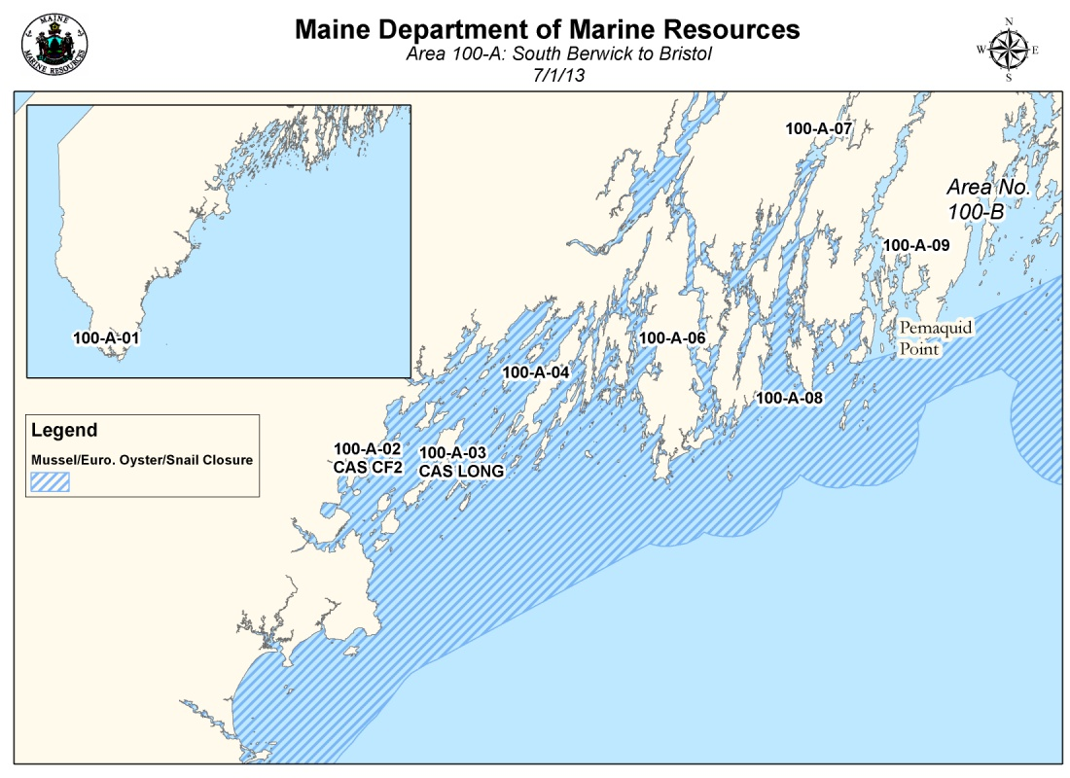
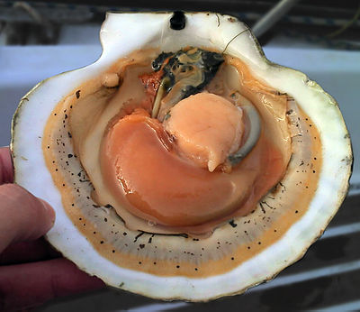
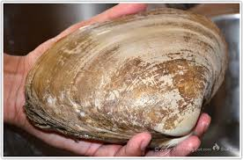
Results
PSP: >80 micrograms of toxin/100 grams of shellfish tissue = CLOSURE
ASP: >20 µg/100g
DSP: >16 µg/100g
Reopen after 2 clean samples at least 7 days apart
Species specific: mussels, soft shelled clams, hard clams, surf clams, oysters, quahogs, scallops

Slide 20
High Risk Species
Scallops whole or roe on pose high risk to consumers as do surf and razor clams
Store toxins for long periods (>1 year)
Transform less toxic compounds into more toxic compounds
Different tissues have different levels of toxin (e.g. meat = 0; roe = minimal; mantel = very high)

Slide 21
High Risk Species Continued
LPAs can not have MOUs for special biotoxin testing
Whole or roe on scallops are not allowed on LPAs
Species like European oysters, surf clams and razor clams are closed and reopened with the regional mussel closure (May-August approximately)
American oysters are closed based on regional sampling of known hot spots

Slide 22
Biotoxin Illnesses
Jonesport 2007: fisherman found floating barrel with mussels, four family members hospitalized, area was closed
Cutler 2008: resident harvested mussels from a floating fish pen, three family members hospitalized, area was closed
Swans Island 2009: resident harvested clams from a closed area and then purged them in another closed area likely making them more toxic

Slide 23
Vibrio Bacteria

Slide 24
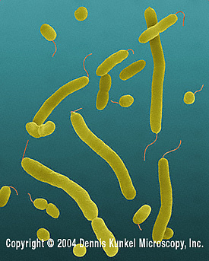
Vibrio spp.
Naturally occurring marine bacteria
Pathogenic strains include:
Vibrio parahaemolyticus
Vibrio vulnificus
Vibrio cholerae
Vibrio fluvialis

Slide 25

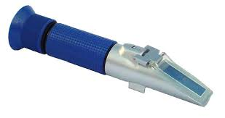
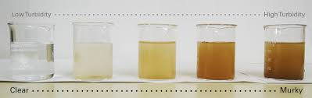
Vibrio ecology
Factors that can affect Vibrio populations and distribution:
Temperature
Salinity
Turbidity
Dissolved oxygen
Phosphorus
Nitrogen
Notes:
Temperature is the most important factor

Slide 26
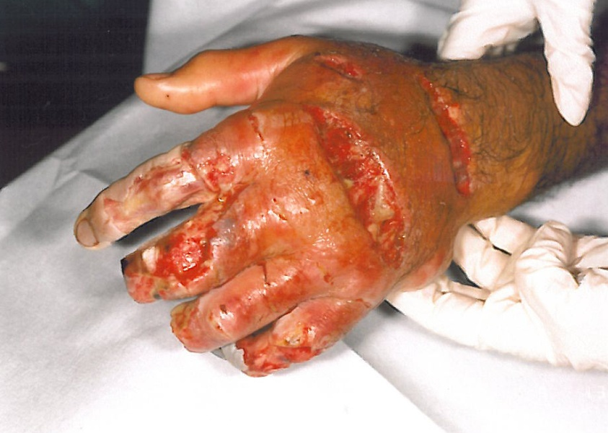
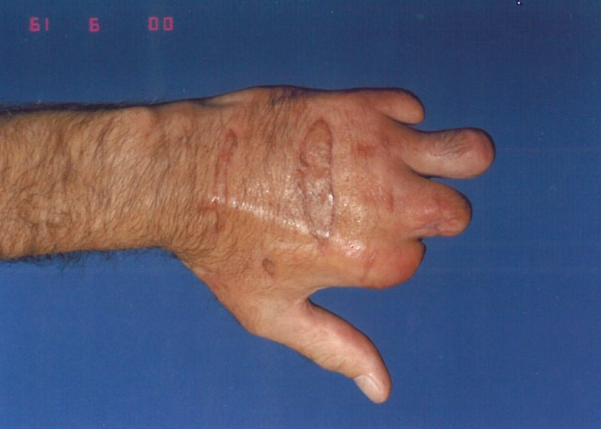
Vibrios and human health-wounds
Wound infections can occur through infection of a pre-existing wound or one obtained during coastal water-related activities
24% cases involved wound infections
Debridement or amputation are common treatments

Slide 27
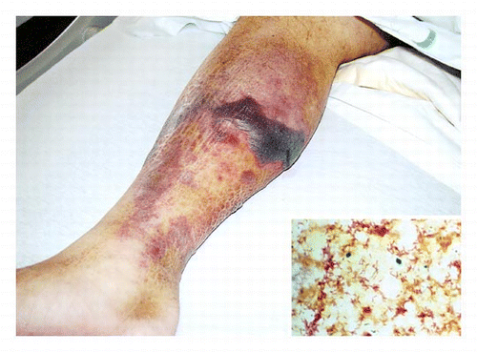
Vibrios and human health-septicemia
Primary septicemia involves fever, shock, diarrhea, vomiting, abdominal cramps and skin lesions
Can be caused by raw shellfish consumption
The fatality rate is up to 75%

Slide 28
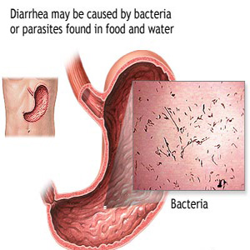
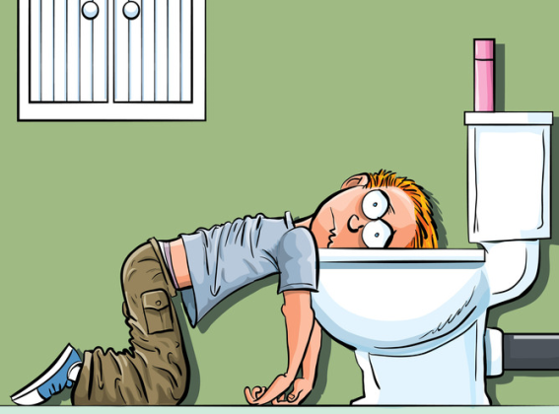
Vibrios and human health-gastroenteritis
Gastroenteritis is characterized as illness with vomiting or diarrhea, abdominal cramps
Can be caused by ingestion of raw seafood
Underreported due to relatively mild symptoms that quickly dissipate in healthy adults

Slide 29
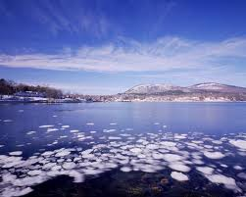
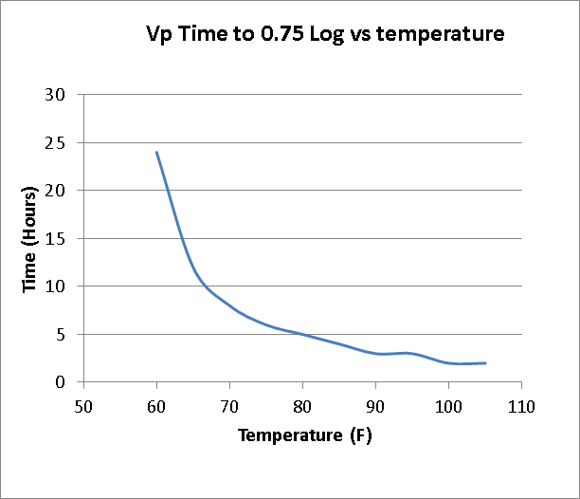
Closures for Vp
Triggered by an outbreak, 2 or more illnesses from a single growing area or by sporadic cases
Reopening basically depends on declining water temperatures
Carter Newell

Slide 30
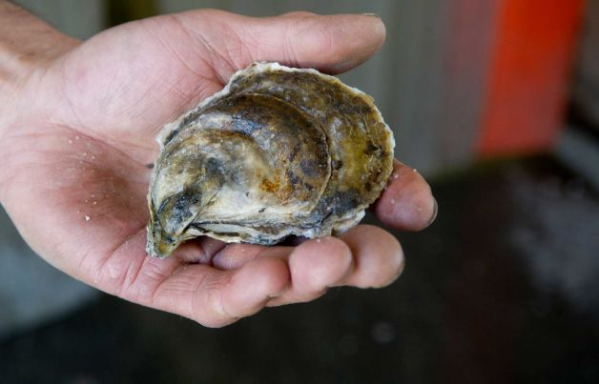
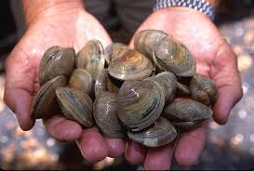
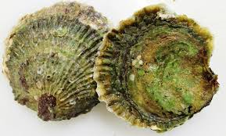
Control Plans: Where? When? What?
Damariscotta and Sheepscot Rivers, Scarborough and Nonesuch Rivers, New Meadows Lakes and Spinney Creek
Effective June 1 to October 15
Oysters and hard clams only
Shading, icing, shorter time to dealers and cooling etc

Slide 31
Best Management Practices
Vibrio does not grow at 50°F or less
The faster product is cooled after harvest the less bacteria it will have
Get product to 50°F quickly and keep it there!
Product at 90°F experiences a doubling of bacteria in one hour
Bacteria are not decreased after cooling you can only prevent the initial growth of bacteria

Slide 32
Tagging, Licensing and Sales

Slide 33
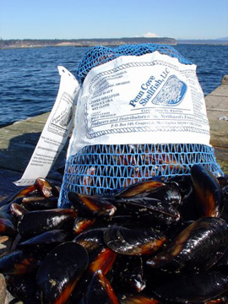
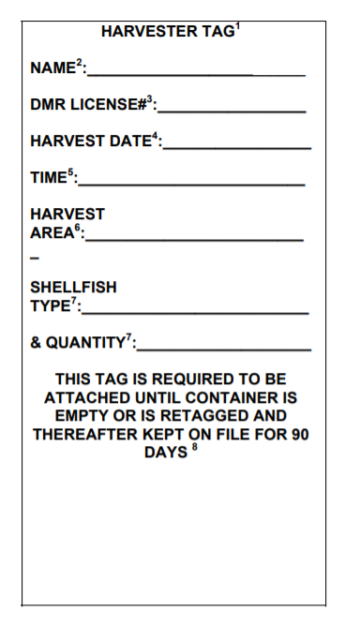
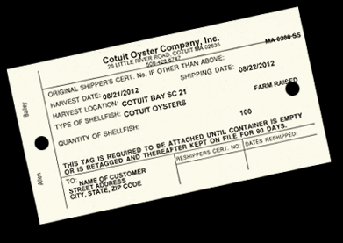
Shellfish Tags
Harvester to Dealer
Dealer to Dealer
Dealer to Retail
Retail retain on file for 90 days
Do not have untagged shellfish

Slide 34
Licensing to Harvest
You must have an Aquaculture License to harvest and move product
You must have a vibrio certification to harvest in the Vibrio control areas during the Vibrio control months
You must also have a commercial shellfish license if you harvest wild product

Slide 35
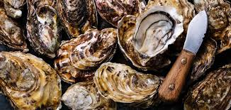
Allowable sales
Sell to a certified shellfish dealer
Sell to an Enhanced Retail Permit holder
Sell directly to consumers from your house
Become a certified shellfish dealer

Slide 36
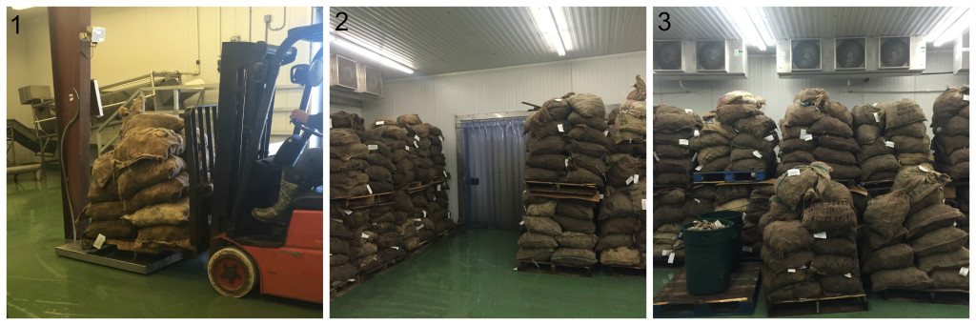
Winter Storage on Land
Must be licensed to harvest
Must use shellfish tags
Must use a certified facility
Size does not matter (e.g. seed)

Slide 37
What about marine algae?

Slide 38
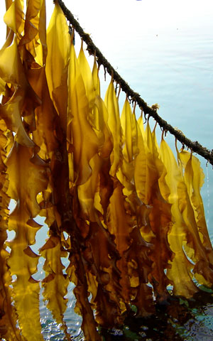
Public Health Concerns
Largely unknown
Some research on surface bacteria/vibrio etc; significant research on metals contamination
Impacts of treatments unknown
Regulation by DACF
DMR issues LPAs/leases only
Prohibition 300:1 EPA toxic mixing zone around a wastewater treatment plant outfall

Slide 39
Thank you for your attention!
Please contact us with questions: DMRPublicHealthDiv@maine.gov

