Slide 1
Invasive Species
Educational Curriculum
High School Program
MAINE DEPARTMENT OF ENVIRONMENTAL PROTECTION
Protecting Maine’s Air, Land and Water

Slide 2
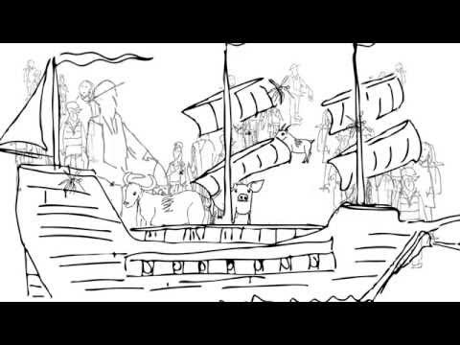

Introduced Species and Biodiversity (Run Time 9:55)
MAINE DEPARTMENT OF ENVIRONMENTAL PROTECTION www.maine.gov/dep
Notes:
Video: https://www.youtube.com/watch?v=J-ftiWffNTc

Slide 3
Definitions
Some terms are used interchangeably, such as nuisance and invasive, both with a negative connotation. Four categories (Binggeli, 1994) serve to cover the concepts used to describe the status and the distribution of a particular species.
Native, Indigenous: species naturally occurring or originating in a geographical region since prehistorical time;
Introduced, Alien, Exotic: deliberate or accidental release of a species into an area in which it has not occurred in historical times;
Invasive: the establishment of self-regenerating and spreading populations of a naturalized species in a free-living state in the wild, takes possession and may affect injuriously;
Nuisance, Noxious, Weed: any plant, either native or introduced, with a harmful or destructive influence on existing natural communities, interfering with the objectives or requirements of people.
Notes:
The "Ten Percent Rule" is a general rule of thumb that says of all non-native species that are released into new ecosystems, about 10% survive at all, and of these survivors, about 10% (or 1% of the original number of species released) become invasive. Nevertheless, there are still hundreds of invasive species established in the US. Source: https://www.epa.gov/watershedacademy/invasive-non-native-species
Definitions: http://www.maine.gov/dep/water/invasives/invmaterial.html

Slide 4
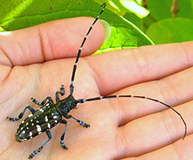
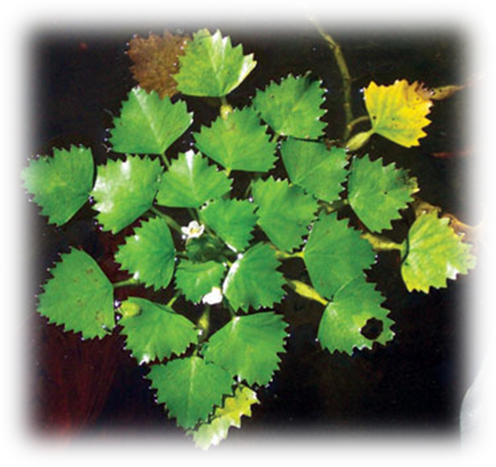
Invasive Aquatic Species
Invasive aquatic species may:
displace native species
degrade native habitats
spread disease
disrupt human social and economic activities that depend on water resources.
MAINE DEPARTMENT OF ENVIRONMENTAL PROTECTION www.maine.gov/dep
Notes:
This invasive aquatic plant was introduced from Europe into New York in the late 1800’s for its ornamental appearance. Its range has been limited to the Atlantic states, but this range is capable of expansion.
Photo & Information: Asian Longhorned Beetle, Photo: Gale Ridge, CAES, http://www.maine.gov/portal/about_me/invasives.html Water http://www.maine.gov/dep/water/invasives/index.html

Slide 5
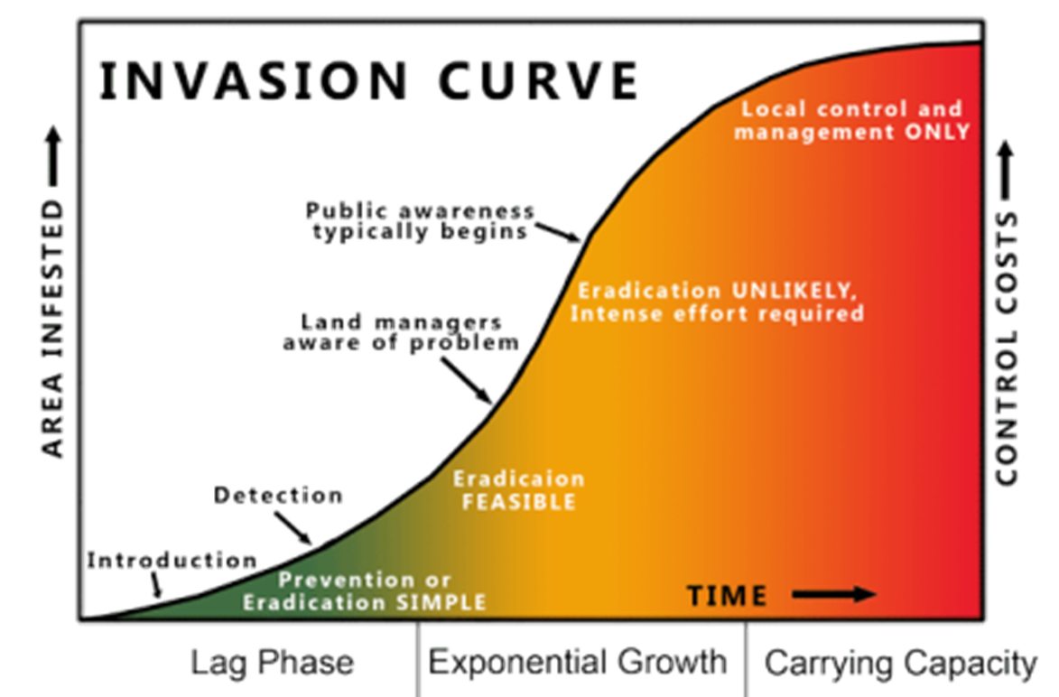
Source: California Department of Fish and Wildlife
Notes:
As this curve shows the area infested and control costs grow exponentially as time progresses. There is only a relatively short time to eradicate an invasive species. Oftentimes the public is not aware of the extent of the issue until the time has come when it is very hard to stop the progression of the species.
Photo: https://www.wildlife.ca.gov/Conservation/Invasives/About

Slide 6
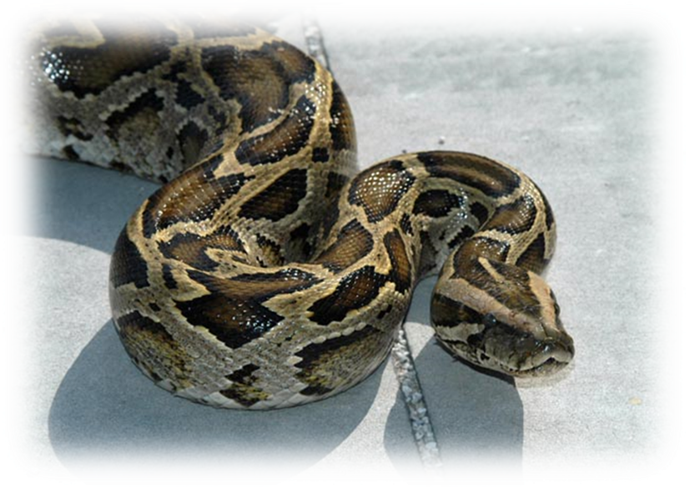
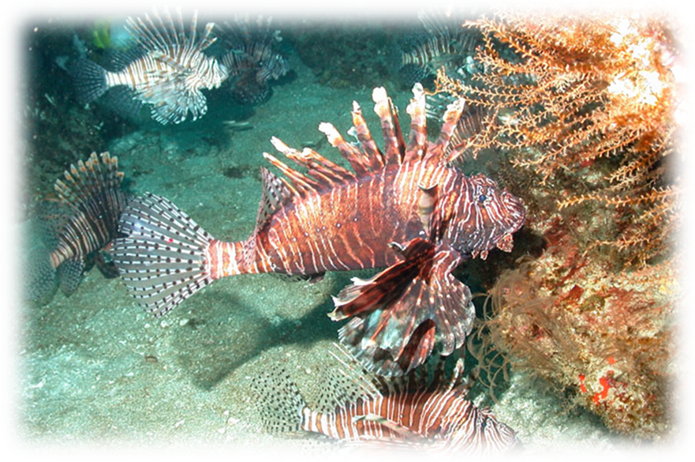
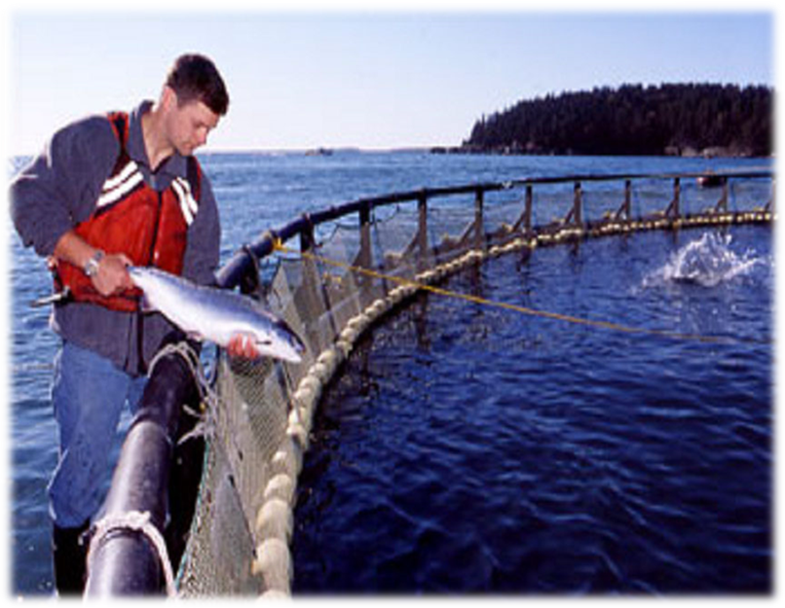
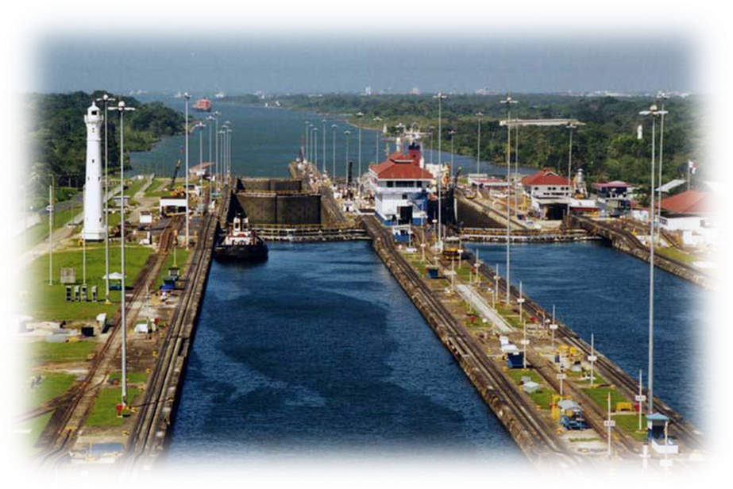
How Do Invasive Aquatic Species Travel?
Animals can travel by
Stocking
Shipping
Aquarium Release
Bait Release
Aquaculture
Canals
Pet Escape
Notes:
Source: summarized from https://www.epa.gov/vessels-marinas-and-ports/aquatic-nuisance-species-ans
Stocking - Species was intentionally planted in the new location; i.e., stocked for sport, storage, stock contamination, bio-control; includes legal and illegal stocking.
Shipping - Ballast water from ships can transport a large volume of water into various geographical areas. Ballast is now regulated (In the United States and many other countries) in terms of treatment. Ships may do a ballast water exchange (swapping out water taken near shore with other water mid-ocean; changing temperatures and salinity levels reduce transfer of organisms) or treat ballast water onboard (there are several commercial disinfection treatments used and approved). It is still an area of concern for travel of invasive aquatic species.
Photo Source: http://blogs.rsc.org/ew/2015/06/12/disinfection-by-products-during-ballast-water-treatment/
Aquarium Release - Species released in the wild by owners who no longer want them, such as the lionfish.
Bait Release - Species introduced as discarded bait.
Aquaculture - Species that escaped from aquaculture facilities.
Canals - Species that gained access to new areas via canals.
Pet escape - Species that were released by pet owners, used mostly to designate amphibian and reptile escapes.

Slide 7
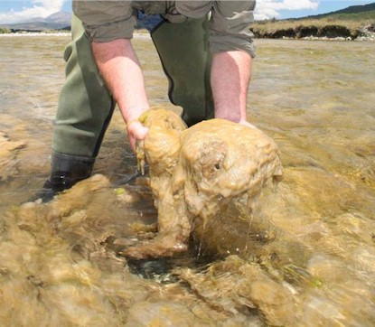
Status of Invasive Aquatic Species
“Status” represents the reproductive population status of the species in that particular location and includes many categories…
Collected
Established
Eradicated
Extirpated
Failed
Stocking
Unknown
Didymo or “Rock Snot” Not Yet Detected in Maine
Notes:
http://nas.er.usgs.gov/about/faq.asp
Collected-species was collected or observed from the site; reproduction is not known - this is the default status; many of these are actually established populations
Established-population is reproducing and overwintering
Eradicated-population was eliminated by human activity, i.e., Rotenone
Extirpated-population died out on its own, without human interference, i.e., cold winter
Failed-population was stocked but died out; failed to reproduce
Stocking- species was introduced.
Unknown - used when all other categories do not fit
Didymo - The aquatic nuisance alga known commonly as "Didymo" ( Didymosphenia geminata ) or "rock snot" has invaded the northern reaches of the Connecticut River in New Hampshire and in the White River and Battenkill River in Vermont. These are the first official reports of the invasive algae in the northeastern U.S.

Slide 8
What’s Happening in Maine?
There are several programs in Maine run by various agencies that strive to reduce the effect of invasive species.
Maine Department of Environmental Protection – Invasive Aquatic Species
Maine Department of Inland Fisheries and Wildlife – Program to cover invasive fish.
Department of Marine Resources covers invasive marine species.

Slide 9
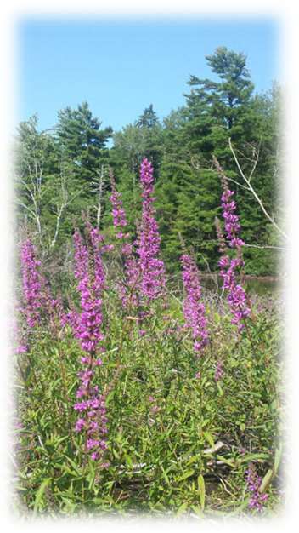
What is an invasive plant?
An invasive plant is defined as a plant that is not native to a particular ecosystem, whose introduction does or is likely to cause economic or environmental harm or harm to human health.
There are currently approximately 2,100 plant species recorded from Maine.
Approximately one third of those is not native.
Of those plants that are not native, only a small fraction are considered invasive, but these have the potential to cause great harm to our landscape.
Notes:
http://www.maine.gov/dacf/mnap/features/Invasive_plants/invasives.htm
Photo: http://www.maine.gov/dacf/mnap/features/invasive_plants/lythrum.htm (Purple Loosestrife)

Slide 10
How do these plants reach our landscape?
In many cases, people have imported invasive species for ornamental and landscaping purposes because many of these species are very attractive.
In other cases, these plant species are purposely planted because they have strong root systems and can provide soil stabilization and prevent erosion.
Accidental introduction through tagging along or hitchhiking with other plants purchased at garden shops and through soil contamination are also possible.
Notes:
http://www.maine.gov/dacf/mnap/features/invasive_plants/invasives.htm

Slide 11
Why are invasive plants so successful on our landscape?
Invasive plant species often lack natural predators, diseases, and other pathogens that keep them in check in their native habitats.
They have competitive adaptations including
early leaf-out,
aggressive reproductive strategies, and
efficient dispersal methods.
In many cases, they take advantage of disturbances, like road construction, and establish themselves before native species can get a foothold.
Notes:
http://www.maine.gov/dacf/mnap/features/invasive_plants/invasives.htm

Slide 12
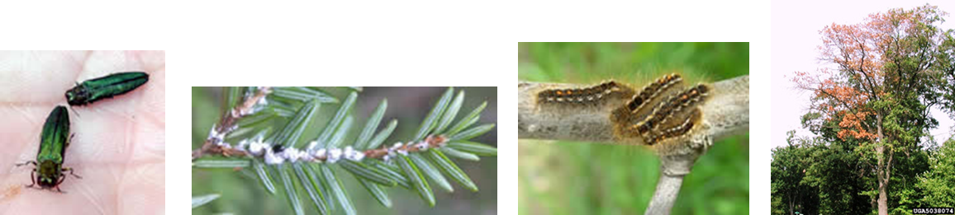
Threats to Forests and Trees
Wood Borers: These insects' worm-like larvae develop beneath the bark or within the wood leaving tunnels as evidence; emerging adults leave holes in the bark.
Piercing-Sucking Insects: These insects feed on fluids of the host plant. Many spend a significant part of their lives attached to the host plant
Defoliators: These insects consume the foliage of host plants.
Disease: Disease can have devastating effects in parts of the United States and has a broad host range.
Notes:
Photos Left to Right: Emerald Ash Borer, Hemlock Wooly Aldegid, Browntail Moth, Oak Wilt Disease –
http://www.maine.gov/dacf/mfs/forest_health/invasive_threats/index.htm

Slide 13
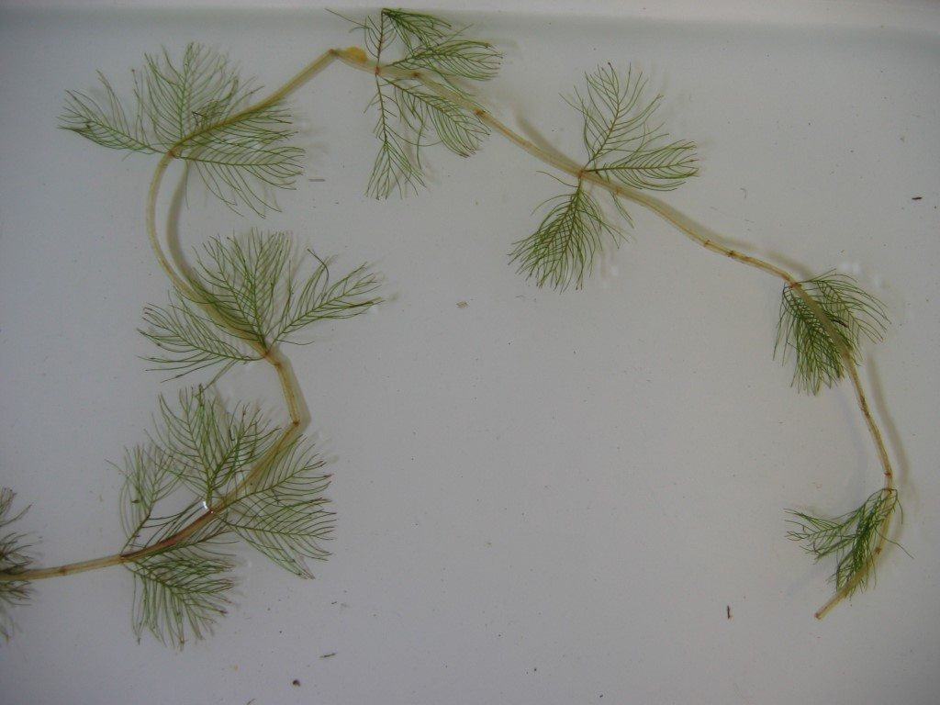
Maine DEP Program Invasive Aquatic Plants
Invasive aquatic species are introduced exotic flora and fauna that displace native plant and animal communities.
Infestations result in
habitat disruption,
loss of property values,
diminished water quality,
reduced fishing and water recreation opportunities and
significant expense for mitigating these environmental costs.
Eurasian Milfoil
Notes:
Eurasian Milfoil - This species of water-milfoil was first discovered in a small pond in Maine in 2003. It is also found in nearby Massachusetts, Vermont, New Hampshire, Connecticut, and the Canadian Provinces. Once introduced into a lake, Eurasian water-milfoil is virtually impossible to eradicate. It grows rapidly and aggressively, reproducing primarily through fragmentation. The introduction of one single fragment of this plant can result in the infestation of an entire lake. Source: http://www.maine.gov/dep/water/invasives/euratext.html

Slide 14
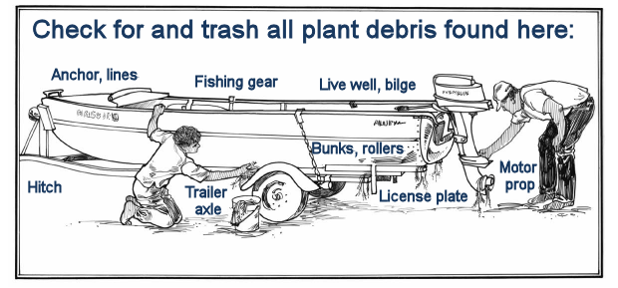
Maine DEP – Invasive Aquatic Plants
Maine DEP's Invasive Aquatic Species Program addresses invasive aquatic species - primarily plants - in three ways: prevention, early detection and control.
Notes:
One method - Maine’s Courtesy Boat Inspection (CBI) Program. The purpose of these voluntary inspections is to reduce the spread of invasive aquatic plants (IAP) by boats, trailers, and associated equipment to Maine waters. Trained Courtesy Boat Inspectors discuss with boaters the risk posed by IAP, show boaters how to inspect and remove vegetation from boating and fishing equipment, and urge boaters to inspect before and after every launch.

Slide 15
What can you do to help?
When buying plants or moving them from place to place consider whether the plants are likely to escape.
Verify that plants you buy for your yard or garden are not invasive. Ask your local garden supplier to include more native species.
Replace invasive plants in your garden with non-invasive alternatives.
When boating, clean your boat thoroughly before transporting it to a different body of water.
Don't release aquarium plants, fish, live bait, or other exotic animals into the wild.
Volunteer at your local park, refuge, or other wildlife area to help remove invasive species. Help educate others about the problem.
Visit http://www.maine.gov/dep/water/invasives/ for more information.
Notes:
Plants advertised as fast growing, prolific, and tolerant of many growing conditions are often the ones that become invasive.

Slide 16
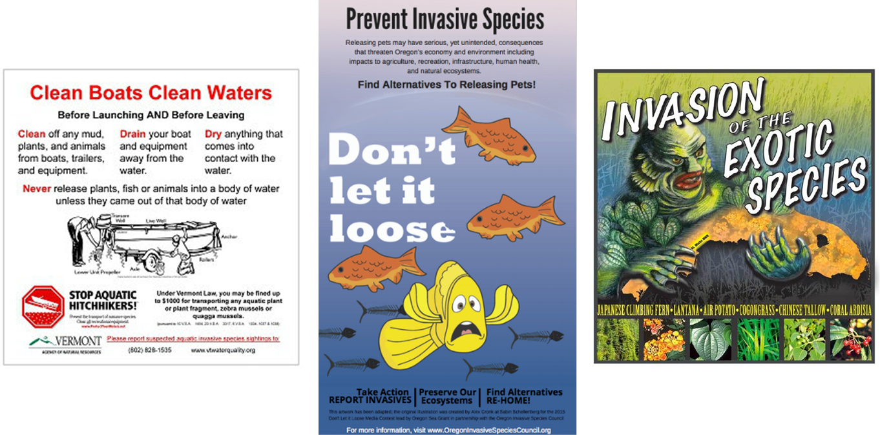
Invasive Species Poster Project Introduction
Notes:
Poster Project/School Newsletter Outreach
Each group shall choose either a Maine invasive species, or a method of transport of these species. Groups shall create informational posters (1 page) highlighting any or all of the following issues:
Name of the species/method of transport
Estimate of introduction to Maine
Issues related to this invasion – environmental, health, economic…
Attempts to halt growth/transfer of species
Maine state agency that works with your issue
How others may find out more information regarding this species
How to report invasive species to the appropriate authorities
Students may start their search for information here: http://www.maine.gov/portal/about_me/invasives.html
These posters may be displayed in classrooms or school hallways to raise awareness of this important issue. In addition, for those schools that send out weekly e-newsletters, these posters could be shared electronically with the greater school community.
Poster examples, left to right - http://dec.vermont.gov/watershed/lakes-ponds/aquatic-invasives, https://www.oregoninvasivespeciescouncil.org/dont-let-it-loose/,
http://illinoisisam.blogspot.com/2013/06/

Slide 17
Add contact information www.maine.gov/dep

