Slide 1
Environmental Careers
Education Curriculum
High School Program
MAINE DEPARTMENT OF ENVIRONMENTAL PROTECTION
Protecting Maine’s Air, Land and Water

Slide 2

Some Environmental Careers
Zoologist/Wildlife Biologists
Environmental Engineers
Environmental Scientists
Hazardous Waste Removal/Spill response
Environmental Science and Protection Technicians
Environmental Education
Conservation/Non-Profit
Chemist
Hydrologist
Geologist
Environmental lawyer
Notes:
See Lesson Plan for details. Each of these selected careers are detailed in the following way 1) what do they do? 2) Where do they work? 3) What education is needed for this type of work?
The next few slides will detail educational levels post high school that may be discussed as typical for an environmental career.

Slide 3

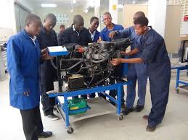

Education Levels to Consider
High School/GED
High School plus industry specific technical training/certification/licensing
College Education with or without specific technical training/certification/licensing
Associate Degree
Bachelor Degree
Master’s Degree
Doctorate
Notes:
High School or General Equivalency Diploma are the minimum needed educational level to work in the environmental careers, for most cases.
Technical Training teaches the skills needed to design, develop, implement, maintain, support or operate a particular technology or related application, product or service. Source: https://www.trainingindustry.com/glossary/technical-training/
An associate degree (or associate's degree) is an undergraduate academic degree awarded by colleges and universities upon completion of a course of study intended to usually last two years. It is considered to be greater level of education than a high school diploma or General Equivalency Diploma (GED). Source: https://en.wikipedia.org/wiki/Associate_degree
A bachelor's degree (from Middle Latin baccalaureus) or baccalaureate (from Modern Latin baccalaureatus) is an undergraduate academic degree awarded by colleges and universities upon completion of a course of study lasting three to seven years – often four years in the U.S. - (depending on institution and academic discipline). Source: https://en.wikipedia.org/wiki/Bachelor%27s_degree
A master's degree (from Latin magister) is usually a second-cycle academic degree awarded by universities or colleges upon completion of a course of study demonstrating mastery or a high-order overview of a specific field of study or area of professional practice. Source: https://en.wikipedia.org/wiki/Master%27s_degree Typically takes several years.
A doctorate (from Latin docere, "to teach") or doctor's degree (from Latin doctor, "teacher") or doctoral degree (from the ancient formalism licentia docendi) is awarded by universities that is, in most countries, a research degree that qualifies the holder to teach at the university level in the degree's field, or to work in a specific profession. Source: https://en.wikipedia.org/wiki/Doctorate

Slide 4
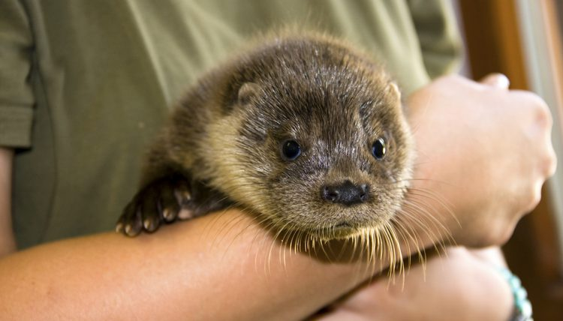
Zoologists/Wildlife Biologists: What do they do?
Zoologists and wildlife biologists study animals and other wildlife and how they interact with their ecosystems.
They study
the physical characteristics of animals
animal behaviors
the impacts humans have on wildlife and natural habitats.
Notes:
https://www.bls.gov/ooh/life-physical-and-social-science/zoologists-and-wildlife-biologists.htm#tab-2
Photo:
https://img-aws.ehowcdn.com/750x428p/photos.demandstudios.com/getty/article/106/206/480840185.jpg

Slide 5
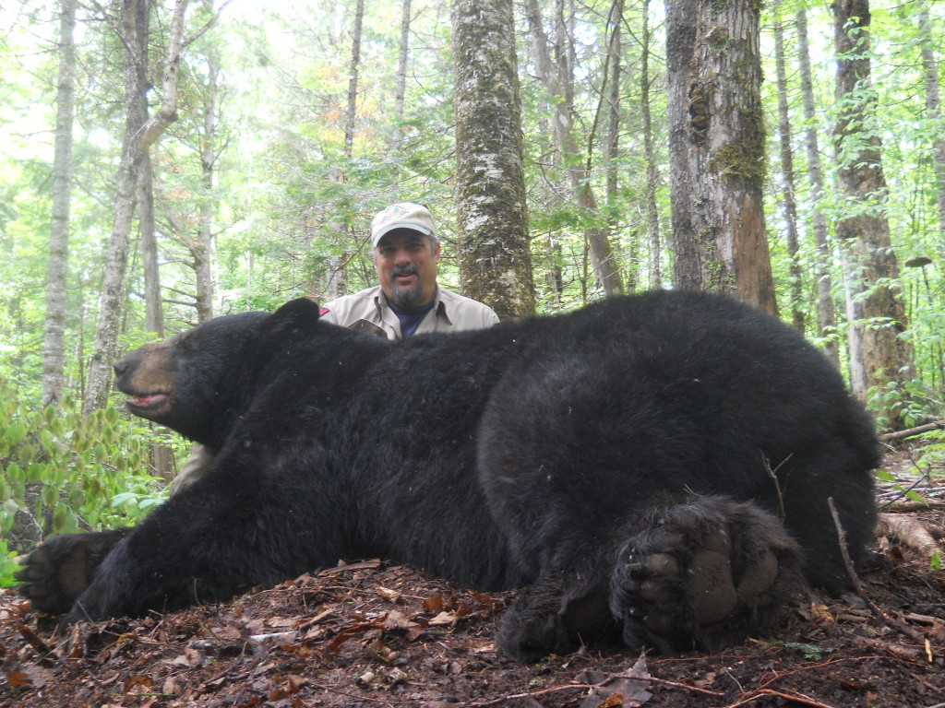
Wildlife Biologist Randy Cross and “Dozer”
Notes:
Shown: Wildlife biologist Randy Cross Sometimes Cross receives a welcome surprise, when bears he “met” before return and temporarily are captured with a cable foot-restraint trap. Cross, who works for the Maine Department of Inland Fisheries and Wildlife, sent a photo of a bear he thinks is one researchers call “Dozer.” Dozer is now a doozie and weighed in at 442 pounds. Cross said the bear was caught in the state’s Bradford study area.
Source: http://outthere.bangordailynews.com/2015/06/19/outdoor-recreation/bear-crew-recaptures-442-pound-male/

Slide 6
Zoologists/Wildlife Biologists: Where do they work?
Zoologists and wildlife biologists work in offices, laboratories, and outdoors.
Depending on their job and interests, they may spend considerable time in the field gathering data and studying animals in their natural habitats.
Other zoologists and wildlife biologists may spend very little time in the field.
Fieldwork can require zoologists and wildlife biologists to travel to remote locations anywhere in the world.
Notes:
https://www.bls.gov/ooh/life-physical-and-social-science/zoologists-and-wildlife-biologists.htm#tab-2

Slide 7
Education Needed for Zoologist/Wildlife Biologist
Zoologists and wildlife biologists typically need at least a bachelor’s degree.
An undergraduate degree in biology with coursework in zoology and wildlife biology typically is good preparation for a career as a zoologist or wildlife biologist.
Zoologists and wildlife biologists typically need at least a master’s degree for higher level investigative or scientific work.
A Ph.D. is necessary for the majority of independent research positions and for university research positions.
Notes:
Zoologists generally specialize first in either vertebrates or invertebrates and then in specific species.
Additional Information – The following are some examples of specialization by species:
Cetologists study marine mammals, such as whales and dolphins.
Entomologists study insects, such as beetles and butterflies.
Herpetologists study reptiles and amphibians, such as snakes and frogs.
Ichthyologists study wild fish, such as sharks and lungfish.
Malacologists study mollusks, such as snails and clams.
Mammalogists study mammals, such as monkeys and bears.
Ornithologists study birds, such as hawks and penguins.
Teuthologists study cephalopods, such as octopuses and cuttlefish
https://www.bls.gov/ooh/life-physical-and-social-science/zoologists-and-wildlife-biologists.htm#tab-2

Slide 8
Environmental Engineers: What do they do?
Environmental engineers use the principles of engineering, science, biology, and chemistry to develop solutions to environmental problems.
They work to improve recycling, waste disposal, public health, and water and air pollution control.
They also address global issues, such as unsafe drinking water, climate change, and environmental sustainability.
Notes:
https://www.bls.gov/ooh/architecture-and-engineering/environmental-engineers.htm

Slide 9
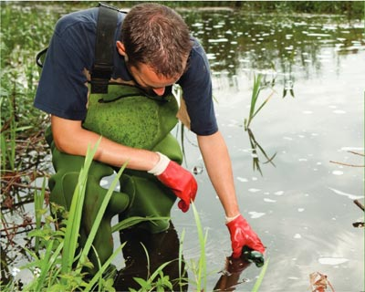
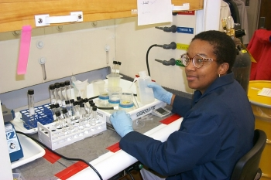
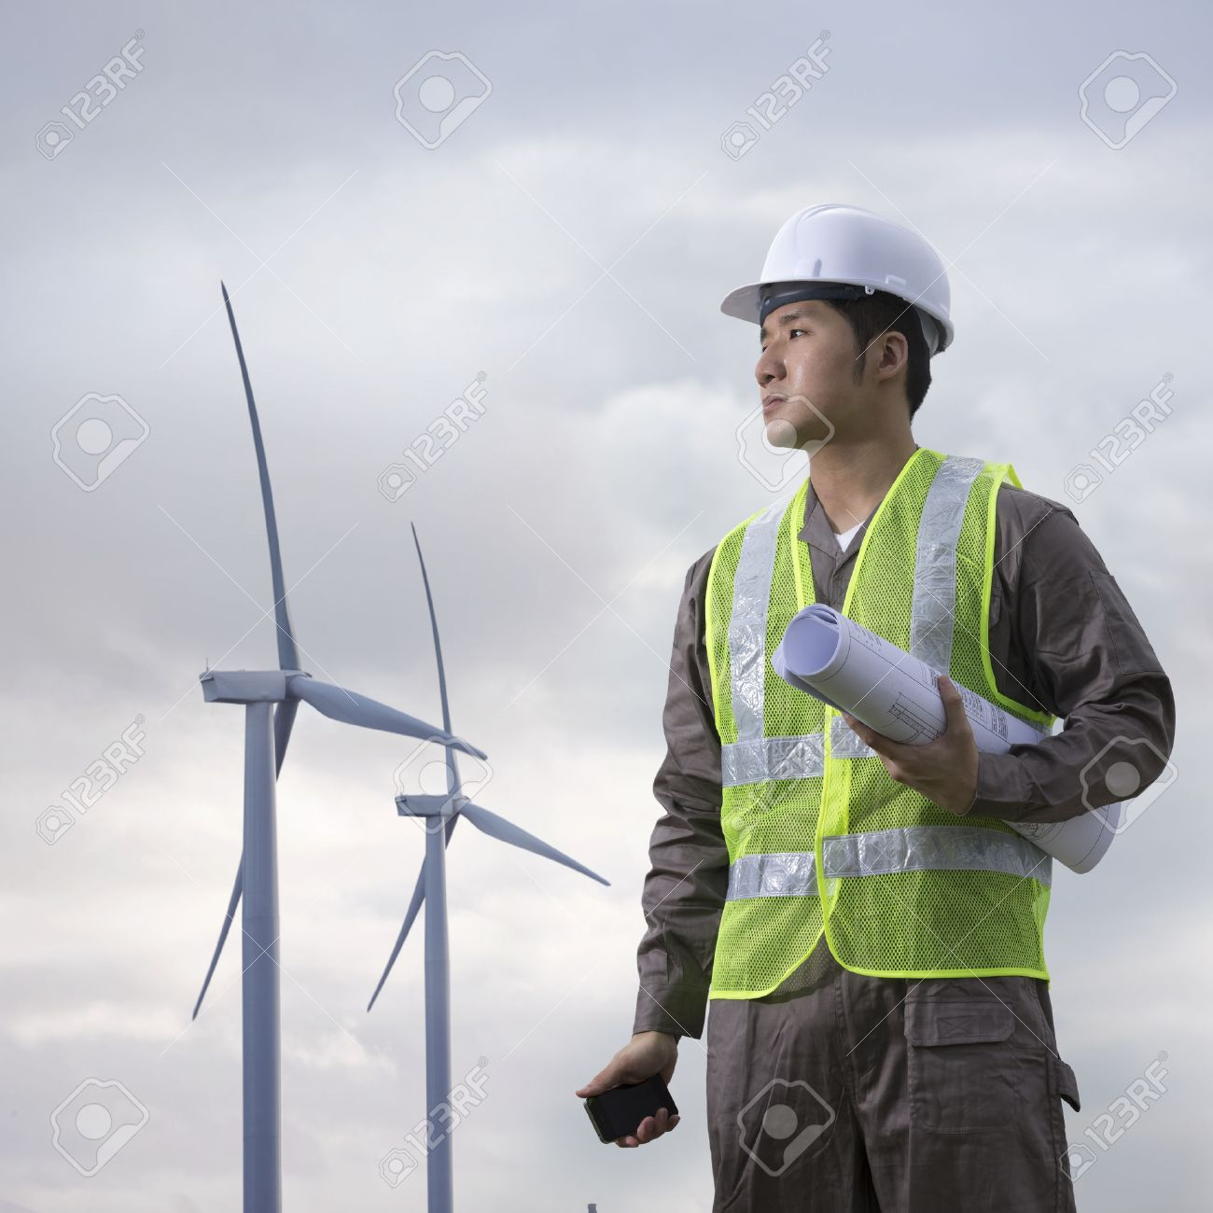
Environmental Engineers
Notes:
Left: UCONN Engineering Ambassador
Middle: Stock Photo
Far right: Dianne Gates-Anderson is an Environmental Process Engineer at Lawrence Livermore National Laboratory (LLNL)
Photo sources: http://theteenagertoday.com/environmental-engineering/, https://www.123rf.com/stock-photo/environmental_engineer.html, https://www.energy.gov/diversity/articles/women-energy-dianne-gates-anderson

Slide 10
Environmental Engineers: Where do they work?
Environmental engineers work in a variety of settings because of the nature of the tasks they do:
When they are working with other engineers and with urban and regional planners, environmental engineers are likely to be in offices.
When they are working with businesspeople and lawyers, environmental engineers are likely to be at seminars, presenting information and answering questions.
When they are working with hazardous materials removal workers and environmental scientists, environmental engineers work at specific sites outdoors.
Notes:
https://www.bls.gov/ooh/architecture-and-engineering/environmental-engineers.htm

Slide 11
Education Needed for Environmental Engineers
Environmental engineers must have a bachelor’s degree in environmental engineering or a related field, such as civil, chemical, or general engineering.
Employers also value practical experience. Therefore, cooperative engineering programs, in which college credit is awarded for structured job experience, are valuable as well.
Notes:
https://www.bls.gov/ooh/architecture-and-engineering/environmental-engineers.htm

Slide 12
Environmental Scientists: What do they do?
Environmental scientists and specialists use their knowledge of the natural sciences to protect the environment and human health.
They may clean up polluted areas, advise policymakers, or work with industry to reduce waste.
Notes:
Duties
Environmental scientists and specialists typically do the following:
Determine data collection methods for research projects, investigations, and surveys
Collect and compile environmental data from samples of air, soil, water, food, and other materials for scientific analysis
Analyze samples, surveys, and other information to identify and assess threats to the environment
Develop plans to prevent, control, or fix environmental problems, such as land or water pollution
Provide information and guidance to government officials, businesses, and the general public on possible environmental hazards and health risks
Prepare technical reports and presentations that explain their research and findings
https://www.bls.gov/ooh/life-physical-and-social-science/environmental-scientists-and-specialists.htm

Slide 13
Environmental Scientists: Where do they work?
Environmental scientists and specialists work in offices and laboratories.
Some may spend time in the field gathering data and monitoring environmental conditions firsthand, but this work is much more likely to be done by environmental science and protection technicians.
Environmental scientists and specialists may have to travel to meet with clients or present research at conferences.
Notes:
https://www.bls.gov/ooh/life-physical-and-social-science/environmental-scientists-and-specialists.htm

Slide 14
Education Needed for Environmental Scientists
For most entry-level jobs, environmental scientists and specialists must have a bachelor’s degree in environmental science or a science-related field, such as biology, chemistry, physics, geosciences, or engineering. However, a master’s degree may be needed for advancement.
Environmental scientists and specialists who have a doctoral degree make up a small percentage of the occupation, and this level of training typically is needed only for the relatively few postsecondary teaching and basic research positions.
Notes:
https://www.bls.gov/ooh/life-physical-and-social-science/environmental-scientists-and-specialists.htm

Slide 15
Hazardous Materials Removal Worker/Spill Response: What do they do?
Hazardous materials (hazmat) removal workers identify and dispose of asbestos, lead, radioactive waste, and other hazardous materials. They also neutralize and clean up materials that are flammable, corrosive, or toxic.
Spill response workers understand: what an spill is, characteristics of a spill response, and how to identify and control hazards pertaining to the response and cleanup activities associated with an spill.
Notes:
What is Hazardous Waste?
A hazardous waste is a waste that exhibits a hazardous characteristic or is a listed waste. There are four criteria that define a characteristic waste. They are:
Ignitability, Corrosivity, Reactivity, Toxicity.
There are also four categories of listed wastes. They are: Non-specific sources, such as a halogenated solvent, Specific sources, such as bottom sludge from wastewater treatment of wood preserving processes that use creosote and/or pentachlorphenol, Commercial chemical products, intermediates or off-specification products. There are two lists for this category, one for acute wastes and one for non-acute wastes. An example of an acute waste is epinephrine. An example of a non-acute waste is naphthalene.
Polychlorinated biphenyl. (PCB's)
http://www.safetybok.org/safety_and_training_of_oil_spill_response_workers/
https://www.bls.gov/ooh/construction-and-extraction/hazardous-materials-removal-workers.htm

Slide 16
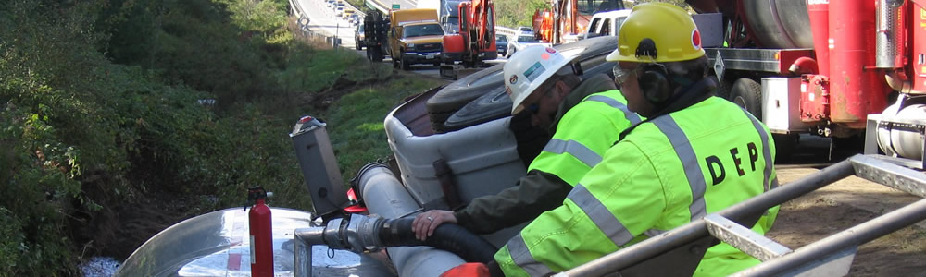
Maine Department of Environmental Protection (DEP) - Spill Response
Notes:
http://www.maine.gov/dep/spills/index.html

Slide 17
Education Needed for Hazardous Waste Removal/Spill Response Workers
Hazmat removal workers typically need a high school diploma. Technical training is required and often very specialized…
Hazmat removal workers receive training on the job. Training generally includes a combination of classroom instruction and fieldwork.
In the classroom, they learn safety procedures and the proper use of personal protective equipment. Onsite, they learn about equipment and chemicals, and are supervised by an experienced worker.
Workers must often complete training in accordance with OSHA standards. The length of training depends on the type of material that the workers handle.
Notes:
The Occupational Safety and Health Administration (OSHA) is an agency of the United States Department of Labor. Source: https://en.wikipedia.org/wiki/Occupational_Safety_and_Health_Administration
https://www.bls.gov/ooh/construction-and-extraction/hazardous-materials-removal-workers.htm

Slide 18
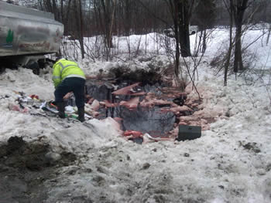
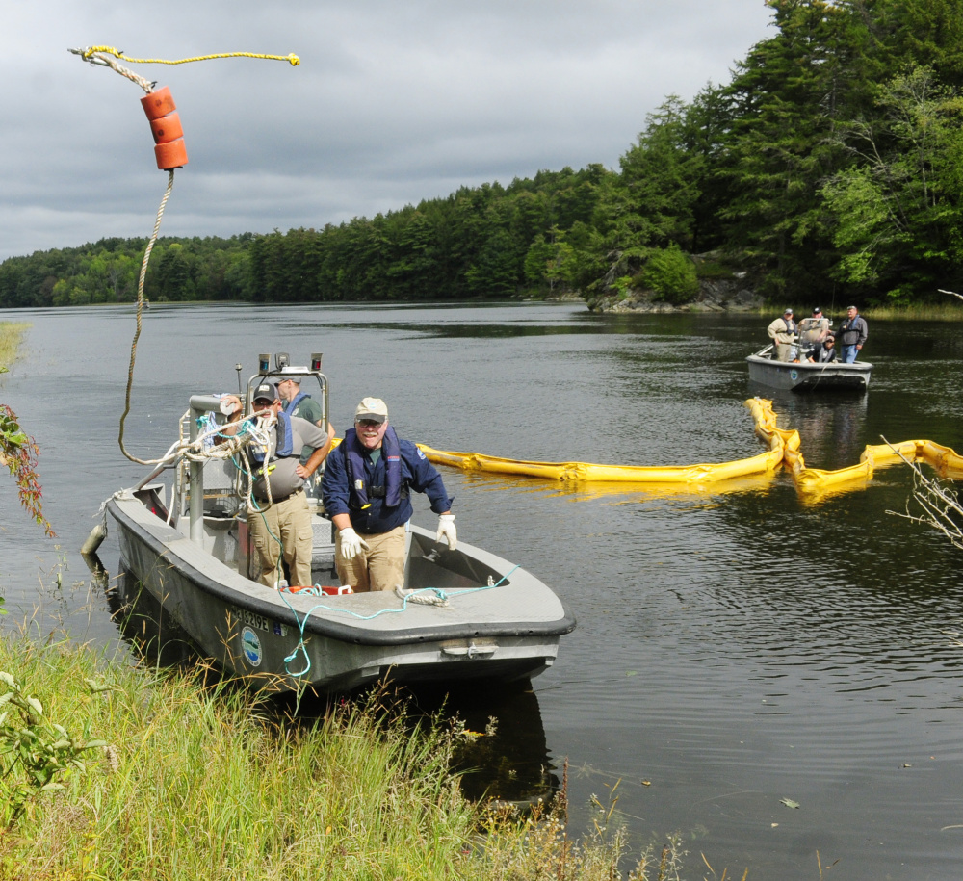
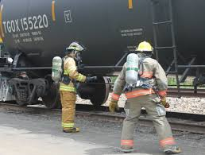
Emergency Responders/Spill Response
Notes:
Left: Oil Spill – Source: http://www.maine.gov/dep/spills/emergspillresp/faqs.html
Middle: Training for rail oil spill response – Source: http://bangordailynews.com/2015/06/17/news/penobscot/agencies-train-in-greenville-for-rail-oil-spill-response/
Right: Department of Environmental Protection Division of Response Services staffer Robert Williams, center, tosses the line from a containment boom to a co-worker on shore on Tuesday during a training exercise in the Kennebec River off Swan Island. Staff photo by Joe Phelan Source: http://www.centralmaine.com/2017/09/19/maine-dep-practices-oil-spill-response-in-richmond/

Slide 19
Hazardous Waste and Spill Response Workers: Where do they work?
Working conditions vary with the hazardous material being removed.
For example, workers removing lead or asbestos often work in confined spaces or at great heights and bend or stoop to remove the material.
Workers responding to emergency and disaster scenarios may work outside in all weather conditions.
Many other workers are employed at facilities such as landfills, incinerators, and industrial furnaces.
Others may work at nuclear facilities and electric power plants.
Notes:
https://www.bls.gov/ooh/construction-and-extraction/hazardous-materials-removal-workers.htm

Slide 20
Environmental Science and Protection Technicians: What do they Do?
Environmental science and protection technicians use laboratory equipment, such as microscopes, to analyze samples collected in the field.
Environmental science and protection technicians monitor the environment and investigate sources of pollution and contamination, including those affecting public health.
Notes:
Environmental science and protection technicians typically do the following:
Inspect establishments, including public places and businesses, to ensure that there are no environmental, health, or safety hazards
Set up and maintain equipment used to monitor pollution levels, such as remote sensors that measure emissions from smokestacks
Collect samples of air, soil, water, and other materials for laboratory analysis
Clearly label, track, and ensure the integrity of samples being transported to the laboratory
Use equipment, such as microscopes, to evaluate and analyze samples for the presence of pollutants or other contaminants
Prepare charts and reports that summarize test results
Discuss test results and analyses with clients
Verify compliance with regulations that help prevent pollution
https://www.bls.gov/ooh/life-physical-and-social-science/environmental-science-and-protection-technicians.htm

Slide 21
Education Needed for Environmental Science and Protection Technicians
Environmental science and protection technicians typically need an associate’s degree in environmental science, environmental health, or public health, or a related degree.
Because of the wide range of tasks, environments, and industries in which these technicians work, there are jobs that do not require postsecondary education and others that require a bachelor’s degree.
Notes:
https://www.bls.gov/ooh/life-physical-and-social-science/environmental-science-and-protection-technicians.htm

Slide 22


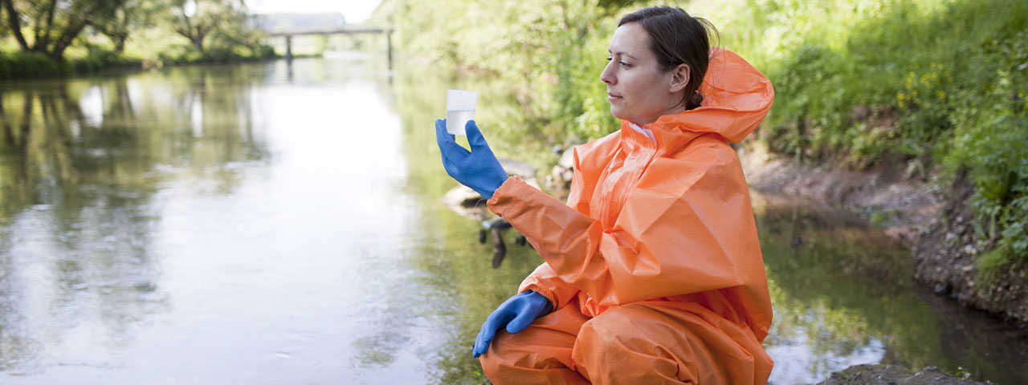
Environmental Science and Protection Technicians: Where do they work?
Environmental science and protection technicians work in
Laboratories
Offices
in the field.
Notes:
https://www.bls.gov/ooh/life-physical-and-social-science/environmental-science-and-protection-technicians.htm
Source of Photos (L to R): https://www.myfuture.com/images/career_assets/civilian/19_4091_00.jpg, https://www.texasgearup.com/public/content/career_190_image_hero.jpg, https://www.bls.gov/ooh/images/2095.jpg

Slide 23
Environmental Education: What do Teachers Do?
Kindergarten and elementary school teachers instruct young students in basic subjects, such as math and reading, in order to prepare them for future schooling.
High school teachers help prepare students for life after graduation. They teach academic lessons and various skills that students will need to attend college and to enter the job market.
Postsecondary teachers instruct students in a wide variety of academic and technical subjects beyond the high school level. They may also conduct research and publish scholarly papers and books.
Notes:
https://www.bls.gov/ooh/education-training-and-library/kindergarten-and-elementary-school-teachers.htm
https://www.bls.gov/ooh/education-training-and-library/high-school-teachers.htm

Slide 24
Education Needed to become a Teacher
Kindergarten, elementary, and high school teachers must have at least a bachelor’s degree. In addition, public school teachers must have a state-issued certification or license.
Post secondary (college) Educational requirements vary by subject and the type of educational institution.
Typically, postsecondary teachers must have a Ph.D.
However, a master's degree may be enough for some postsecondary teachers at community colleges, and others may need work experience in their field of expertise.
Notes:
https://www.bls.gov/ooh/education-training-and-library/high-school-teachers.htm

Slide 25



Education
Notes:
Photo left: kindergarten and elementary – Source: https://www.bls.gov/ooh/images/2175.jpg
Middle: high school – Source: https://makeitbetter.net/wp-content/uploads/2016/08/5-Things-Your-Childs-High-School-Teachers-Want-You-to-Know.jpg
Right: college: https://images.csmonitor.com/csm/2013/03/COLLEGE%20TEACHING.jpg?alias=standard_600x400

Slide 26
Environmental Conservation and/or Non-Profit Work
Conservationists manage environmental protection efforts in order to balance the needs of human users with environmental health.
They manage projects that maintain ecosystem health and protect natural resources from a variety of threats.
They are involved in land-use negotiations to meet the needs of users like farmers and other landowners.
Some conservationists specialize in a particular area of the field, such as range management, land management or soil and water conservation.
Notes:
https://learn.org/articles/How_Do_I_Become_a_Conservationist.html

Slide 27

Environmental Conservation and/or Non-Profit Work
Work in this area can vary widely depending on your area of interest and your level of education.

Slide 28
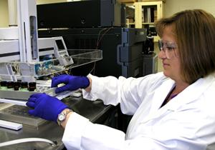
Chemists: What do they do?
Chemists and materials scientists study substances at the atomic and molecular levels and analyze the ways in which the substances interact with one another.
Notes:
EPA Scientist Jody Shoemaker – source: https://www.google.com/search?rlz=1C1GGRV_enUS751US751&biw=1227&bih=577&tbm=isch&sa=1&ei=mIrnWt7LHfGm_QaokJiABQ&q=epa+chemist&oq=epa+chemist&gs_l=psy-ab.3..0i24k1l4.2321.3908.0.4751.12.8.0.0.0.0.148.863.3j5.8.0....0...1c.1.64.psy-ab..7.5.550....0._kb0KNiivrE#imgrc=BJemLTp6HiOH4M:

Slide 29

Chemists: Where do they work?
Chemists and materials scientists work in laboratories, the field, and offices. They typically work full time and keep regular hours.
Notes:
EPA Chemist Quincy Teng, Ph.D.
Source: https://www.google.com/search?rlz=1C1GGRV_enUS751US751&biw=1227&bih=577&tbm=isch&sa=1&ei=mIrnWt7LHfGm_QaokJiABQ&q=epa+chemist&oq=epa+chemist&gs_l=psy-ab.3..0i24k1l4.2321.3908.0.4751.12.8.0.0.0.0.148.863.3j5.8.0....0...1c.1.64.psy-ab..7.5.550....0._kb0KNiivrE#imgrc=1xH2MbLQONCqIM:

Slide 30
Education Needed to Become a Chemist
Chemists and materials scientists need at least a bachelor’s degree in chemistry or a related field. However, a master’s degree or Ph.D. is needed for many research jobs.

Slide 31
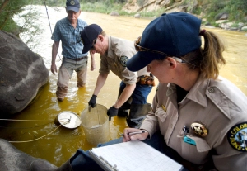
Hydrologists: What do They Do?
Hydrologists study how water moves across and through the Earth’s crust.
They use their expertise to solve problems in the areas of water quality or availability.
Notes:
https://filtercon.wordpress.com/tag/durango/

Slide 32
Hydrologists: Where Do They Work?
Hydrologists work in offices and in the field.
In offices, hydrologists spend much of their time using computers to analyze data and model their findings.
In the field, hydrologists may have to wade into lakes and streams to collect samples or to read and inspect monitoring equipment.

Slide 33
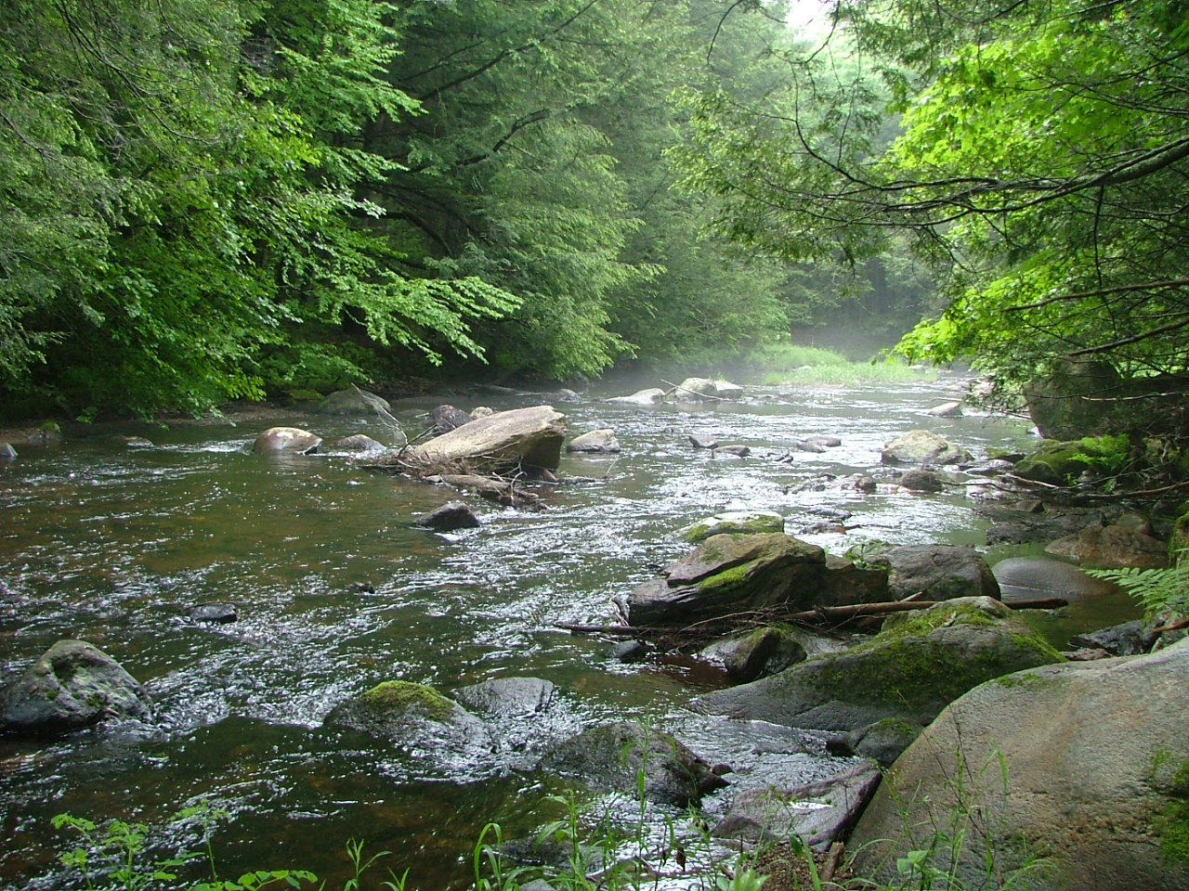
Education Needed to Become A Hydrologist
Hydrologists need at least a bachelor’s degree for entry-level positions; however, some workers begin their careers with a master’s degree.
Notes:
Photo: Farmington River Watershed Association

Slide 34
Geologists: What Do They Do?
Study the composition, structure, and history of the earth's crust.
Examine rocks, minerals, and fossil remains to identify and determine sequence of processes affecting development of the earth.
Apply knowledge of chemistry, physics, biology, and mathematics to explain these phenomena and to help locate mineral and petroleum deposits and underground water resources.
Prepare geologic reports and maps, interpret data and recommend further study or action.

Slide 35
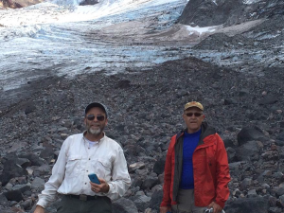
Geologists: Where Do They Work?
Most split their time between working indoors in offices and laboratories and working outdoors.
Notes:
Peter Beedlow with EPA colleague Steve Cline at the foot of Collier Glacier where they were tasked with retrieving government equipment from the face of Collier Glacier in the Three Sisters Wilderness area of Oregon’s Deschutes National Forest.
Source: https://blog.epa.gov/blog/tag/usgs/

Slide 36
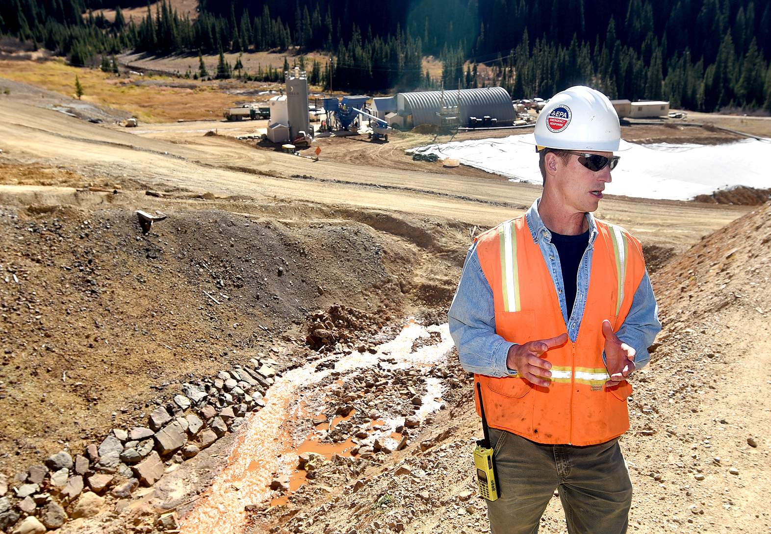
Education Needed to Become a Geologist
Geologists typically need at least a bachelor’s degree for most entry-level positions.
Notes:
Steve Way, on-scene coordinator for the EPA, stands in front of the facility that treats water coming out of the Gold King Mine.
Source: https://www.google.com/search?q=EPA+geologist&rlz=1C1GGRV_enUS751US751&source=lnms&tbm=isch&sa=X&ved=2ahUKEwiGv9ay-uLaAhWSct8KHZXGCIgQ_AUoAnoECAAQBA&biw=1227&bih=577#imgrc=I44es2UW0b-IlM:

Slide 37
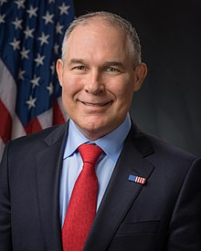
Environmental Lawyer: What Do They Do?
Lawyers advise and represent individuals, businesses, and government agencies on legal issues and disputes.
Notes:
Scott Pruitt, Administrater of the EPA, J.D.

Slide 38
Environmental Lawyers: Where do They Work?
Many lawyers work in private and corporate legal offices.
Some work for federal, local, and state governments.
Most work full time, and many work more than 40 hours a week.

Slide 39

Education Needed for An Environmental Lawyer
Lawyers must have a law degree and must also typically pass a state’s written bar examination.
Notes:
Many people become lawyers by getting a bachelors degree (4 years) and then going on to several more years (3 or more) of law school.

Slide 40

www.maine.gov/dep

